Slide 1
Greek Participles
Prof. Vanessa Gorman
University of Nebraska-Lincoln
vgorman1@unl.edu

Slide 2
Morphology of Greek Participles

Slide 3
Participle = verbal adjective
Built from a verb stem
As an adjective/noun, it has number, gender, and case
It modifies a noun [sometimes unexpressed]
It follows the rules of agreement toward the noun it is modifying
It can be substantized
As a verb, it has tense/aspect and voice.
It may have arguments [SBJ, OBJ, PNOM, OCOMP]
It may have ancillaries [ADV]

Slide 4
In English, usually translated –ing [pres] or –ed [past]
Walking is good exercise. [SBJ]
He will prove to have done nothing wrong [PNOM with its own OBJ]
She hurried along, not stopping to pick up the paper she dropped. [ADV with its own OBJ]
I drank bottled water. [ATR]
All things being equal, I would prefer to go home now. [ADV used absolutely]

Slide 5
Top 20 Participles in Hellenika 1-3 (by lemma)
rank | lemma | count | mas | fem | nt | present | aor | perf | fut | act | middle | MP | pass
1 | εἰμί | 136 | 93 | 25 | 18 | 135 | 0 | 0 | 1 | 135 | 1 | 0 | 0
2 | ἔχω | 68 | 60 | 6 | 2 | 68 | 0 | 0 | 0 | 66 | 0 | 2 | 0
3 | γίγνομαι | 36 | 14 | 10 | 12 | 7 | 22 | 7 | 0 | 2 | 22 | 12 | 0
4 | πράσσω | 29 | 16 | 0 | 13 | 8 | 11 | 8 | 2 | 15 | 1 | 10 | 3
5 | λαμβάνω | 28 | 27 | 1 | 0 | 2 | 24 | 1 | 1 | 25 | 1 | 1 | 1
6 | πέμπω | 28 | 27 | 0 | 1 | 7 | 21 | 0 | 0 | 21 | 0 | 1 | 6
7 | ἄρχω | 26 | 23 | 0 | 3 | 19 | 5 | 2 | 0 | 18 | 2 | 6 | 0
8 | ποιέω | 24 | 23 | 1 | 0 | 7 | 14 | 3 | 0 | 18 | 3 | 3 | 0
9 | βούλομαι | 24 | 23 | 1 | 0 | 24 | 0 | 0 | 0 | 0 | 0 | 24 | 0
10 | λέγω3 | 22 | 19 | 3 | 0 | 20 | 2 | 0 | 0 | 18 | 2 | 2 | 0
11 | νομίζω | 21 | 21 | 0 | 0 | 16 | 5 | 0 | 0 | 21 | 0 | 0 | 0
12 | εἶπον | 20 | 20 | 0 | 0 | 0 | 20 | 0 | 0 | 20 | 0 | 0 | 0
13 | ἀκούω | 18 | 17 | 1 | 0 | 6 | 12 | 0 | 0 | 18 | 0 | 0 | 0
14 | γιγνώσκω | 17 | 16 | 1 | 0 | 10 | 7 | 0 | 0 | 17 | 0 | 0 | 0
15 | ἀφικνέομαι | 15 | 13 | 2 | 0 | 2 | 13 | 0 | 0 | 0 | 13 | 2 | 0
16 | ἄγω | 15 | 15 | 0 | 0 | 12 | 2 | 0 | 1 | 14 | 1 | 0 | 0
17 | φάσκω | 15 | 15 | 0 | 0 | 15 | 0 | 0 | 0 | 15 | 0 | 0 | 0
18 | θύω1 | 14 | 12 | 0 | 2 | 7 | 4 | 3 | 0 | 7 | 7 | 0 | 0
19 | ἔρχομαι | 14 | 13 | 1 | 0 | 0 | 14 | 0 | 0 | 14 | 0 | 0 | 0
20 | δοκέω | 13 | 9 | 0 | 4 | 8 | 5 | 0 | 0 | 13 | 0 | 0 | 0
 | SUM |  | 476 | 52 | 55 | 373 | 181 | 24 | 5 | 457 | 53 | 63 | 10

Slide 6
Only 12 lemmas occur more than 20x total
rank | lemma | count | mas | fem | nt | present | aor | perf | fut | act | middle | MP | pass
1 | εἰμί | 136 | 93 | 25 | 18 | 135 | 0 | 0 | 1 | 135 | 1 | 0 | 0
2 | ἔχω | 68 | 60 | 6 | 2 | 68 | 0 | 0 | 0 | 66 | 0 | 2 | 0
3 | γίγνομαι | 36 | 14 | 10 | 12 | 7 | 22 | 7 | 0 | 2 | 22 | 12 | 0
4 | πράσσω | 29 | 16 | 0 | 13 | 8 | 11 | 8 | 2 | 15 | 1 | 10 | 3
5 | λαμβάνω | 28 | 27 | 1 | 0 | 2 | 24 | 1 | 1 | 25 | 1 | 1 | 1
6 | πέμπω | 28 | 27 | 0 | 1 | 7 | 21 | 0 | 0 | 21 | 0 | 1 | 6
7 | ἄρχω | 26 | 23 | 0 | 3 | 19 | 5 | 2 | 0 | 18 | 2 | 6 | 0
8 | ποιέω | 24 | 23 | 1 | 0 | 7 | 14 | 3 | 0 | 18 | 3 | 3 | 0
9 | βούλομαι | 24 | 23 | 1 | 0 | 24 | 0 | 0 | 0 | 0 | 0 | 24 | 0
10 | λέγω3 | 22 | 19 | 3 | 0 | 20 | 2 | 0 | 0 | 18 | 2 | 2 | 0
11 | νομίζω | 21 | 21 | 0 | 0 | 16 | 5 | 0 | 0 | 21 | 0 | 0 | 0
12 | εἶπον | 20 | 20 | 0 | 0 | 0 | 20 | 0 | 0 | 20 | 0 | 0 | 0
13 | ἀκούω | 18 | 17 | 1 | 0 | 6 | 12 | 0 | 0 | 18 | 0 | 0 | 0
14 | γιγνώσκω | 17 | 16 | 1 | 0 | 10 | 7 | 0 | 0 | 17 | 0 | 0 | 0
15 | ἀφικνέομαι | 15 | 13 | 2 | 0 | 2 | 13 | 0 | 0 | 0 | 13 | 2 | 0
16 | ἄγω | 15 | 15 | 0 | 0 | 12 | 2 | 0 | 1 | 14 | 1 | 0 | 0
17 | φάσκω | 15 | 15 | 0 | 0 | 15 | 0 | 0 | 0 | 15 | 0 | 0 | 0
18 | θύω1 | 14 | 12 | 0 | 2 | 7 | 4 | 3 | 0 | 7 | 7 | 0 | 0
19 | ἔρχομαι | 14 | 13 | 1 | 0 | 0 | 14 | 0 | 0 | 14 | 0 | 0 | 0
20 | δοκέω | 13 | 9 | 0 | 4 | 8 | 5 | 0 | 0 | 13 | 0 | 0 | 0
 | SUM |  | 476 | 52 | 55 | 373 | 181 | 24 | 5 | 457 | 53 | 63 | 10

Slide 7
The great majority are masculine
rank | lemma | count | mas | fem | nt | present | aor | perf | fut | act | middle | MP | pass
1 | εἰμί | 136 | 93 | 25 | 18 | 135 | 0 | 0 | 1 | 135 | 1 | 0 | 0
2 | ἔχω | 68 | 60 | 6 | 2 | 68 | 0 | 0 | 0 | 66 | 0 | 2 | 0
3 | γίγνομαι | 36 | 14 | 10 | 12 | 7 | 22 | 7 | 0 | 2 | 22 | 12 | 0
4 | πράσσω | 29 | 16 | 0 | 13 | 8 | 11 | 8 | 2 | 15 | 1 | 10 | 3
5 | λαμβάνω | 28 | 27 | 1 | 0 | 2 | 24 | 1 | 1 | 25 | 1 | 1 | 1
6 | πέμπω | 28 | 27 | 0 | 1 | 7 | 21 | 0 | 0 | 21 | 0 | 1 | 6
7 | ἄρχω | 26 | 23 | 0 | 3 | 19 | 5 | 2 | 0 | 18 | 2 | 6 | 0
8 | ποιέω | 24 | 23 | 1 | 0 | 7 | 14 | 3 | 0 | 18 | 3 | 3 | 0
9 | βούλομαι | 24 | 23 | 1 | 0 | 24 | 0 | 0 | 0 | 0 | 0 | 24 | 0
10 | λέγω3 | 22 | 19 | 3 | 0 | 20 | 2 | 0 | 0 | 18 | 2 | 2 | 0
11 | νομίζω | 21 | 21 | 0 | 0 | 16 | 5 | 0 | 0 | 21 | 0 | 0 | 0
12 | εἶπον | 20 | 20 | 0 | 0 | 0 | 20 | 0 | 0 | 20 | 0 | 0 | 0
13 | ἀκούω | 18 | 17 | 1 | 0 | 6 | 12 | 0 | 0 | 18 | 0 | 0 | 0
14 | γιγνώσκω | 17 | 16 | 1 | 0 | 10 | 7 | 0 | 0 | 17 | 0 | 0 | 0
15 | ἀφικνέομαι | 15 | 13 | 2 | 0 | 2 | 13 | 0 | 0 | 0 | 13 | 2 | 0
16 | ἄγω | 15 | 15 | 0 | 0 | 12 | 2 | 0 | 1 | 14 | 1 | 0 | 0
17 | φάσκω | 15 | 15 | 0 | 0 | 15 | 0 | 0 | 0 | 15 | 0 | 0 | 0
18 | θύω1 | 14 | 12 | 0 | 2 | 7 | 4 | 3 | 0 | 7 | 7 | 0 | 0
19 | ἔρχομαι | 14 | 13 | 1 | 0 | 0 | 14 | 0 | 0 | 14 | 0 | 0 | 0
20 | δοκέω | 13 | 9 | 0 | 4 | 8 | 5 | 0 | 0 | 13 | 0 | 0 | 0
 | SUM |  | 476 | 52 | 55 | 373 | 181 | 24 | 5 | 457 | 53 | 63 | 10

Slide 8
Three are commonly feminine and/or neuter as well
rank | lemma | count | mas | fem | nt | present | aor | perf | fut | act | middle | MP | pass
1 | εἰμί | 136 | 93 | 25 | 18 | 135 | 0 | 0 | 1 | 135 | 1 | 0 | 0
2 | ἔχω | 68 | 60 | 6 | 2 | 68 | 0 | 0 | 0 | 66 | 0 | 2 | 0
3 | γίγνομαι | 36 | 14 | 10 | 12 | 7 | 22 | 7 | 0 | 2 | 22 | 12 | 0
4 | πράσσω | 29 | 16 | 0 | 13 | 8 | 11 | 8 | 2 | 15 | 1 | 10 | 3
5 | λαμβάνω | 28 | 27 | 1 | 0 | 2 | 24 | 1 | 1 | 25 | 1 | 1 | 1
6 | πέμπω | 28 | 27 | 0 | 1 | 7 | 21 | 0 | 0 | 21 | 0 | 1 | 6
7 | ἄρχω | 26 | 23 | 0 | 3 | 19 | 5 | 2 | 0 | 18 | 2 | 6 | 0
8 | ποιέω | 24 | 23 | 1 | 0 | 7 | 14 | 3 | 0 | 18 | 3 | 3 | 0
9 | βούλομαι | 24 | 23 | 1 | 0 | 24 | 0 | 0 | 0 | 0 | 0 | 24 | 0
10 | λέγω3 | 22 | 19 | 3 | 0 | 20 | 2 | 0 | 0 | 18 | 2 | 2 | 0
11 | νομίζω | 21 | 21 | 0 | 0 | 16 | 5 | 0 | 0 | 21 | 0 | 0 | 0
12 | εἶπον | 20 | 20 | 0 | 0 | 0 | 20 | 0 | 0 | 20 | 0 | 0 | 0
13 | ἀκούω | 18 | 17 | 1 | 0 | 6 | 12 | 0 | 0 | 18 | 0 | 0 | 0
14 | γιγνώσκω | 17 | 16 | 1 | 0 | 10 | 7 | 0 | 0 | 17 | 0 | 0 | 0
15 | ἀφικνέομαι | 15 | 13 | 2 | 0 | 2 | 13 | 0 | 0 | 0 | 13 | 2 | 0
16 | ἄγω | 15 | 15 | 0 | 0 | 12 | 2 | 0 | 1 | 14 | 1 | 0 | 0
17 | φάσκω | 15 | 15 | 0 | 0 | 15 | 0 | 0 | 0 | 15 | 0 | 0 | 0
18 | θύω1 | 14 | 12 | 0 | 2 | 7 | 4 | 3 | 0 | 7 | 7 | 0 | 0
19 | ἔρχομαι | 14 | 13 | 1 | 0 | 0 | 14 | 0 | 0 | 14 | 0 | 0 | 0
20 | δοκέω | 13 | 9 | 0 | 4 | 8 | 5 | 0 | 0 | 13 | 0 | 0 | 0
 | SUM |  | 476 | 52 | 55 | 373 | 181 | 24 | 5 | 457 | 53 | 63 | 10

Slide 9
The great majority are Present or Aorist
rank | lemma | count | mas | fem | nt | present | aor | perf | fut | act | middle | MP | pass
1 | εἰμί | 136 | 93 | 25 | 18 | 135 | 0 | 0 | 1 | 135 | 1 | 0 | 0
2 | ἔχω | 68 | 60 | 6 | 2 | 68 | 0 | 0 | 0 | 66 | 0 | 2 | 0
3 | γίγνομαι | 36 | 14 | 10 | 12 | 7 | 22 | 7 | 0 | 2 | 22 | 12 | 0
4 | πράσσω | 29 | 16 | 0 | 13 | 8 | 11 | 8 | 2 | 15 | 1 | 10 | 3
5 | λαμβάνω | 28 | 27 | 1 | 0 | 2 | 24 | 1 | 1 | 25 | 1 | 1 | 1
6 | πέμπω | 28 | 27 | 0 | 1 | 7 | 21 | 0 | 0 | 21 | 0 | 1 | 6
7 | ἄρχω | 26 | 23 | 0 | 3 | 19 | 5 | 2 | 0 | 18 | 2 | 6 | 0
8 | ποιέω | 24 | 23 | 1 | 0 | 7 | 14 | 3 | 0 | 18 | 3 | 3 | 0
9 | βούλομαι | 24 | 23 | 1 | 0 | 24 | 0 | 0 | 0 | 0 | 0 | 24 | 0
10 | λέγω3 | 22 | 19 | 3 | 0 | 20 | 2 | 0 | 0 | 18 | 2 | 2 | 0
11 | νομίζω | 21 | 21 | 0 | 0 | 16 | 5 | 0 | 0 | 21 | 0 | 0 | 0
12 | εἶπον | 20 | 20 | 0 | 0 | 0 | 20 | 0 | 0 | 20 | 0 | 0 | 0
13 | ἀκούω | 18 | 17 | 1 | 0 | 6 | 12 | 0 | 0 | 18 | 0 | 0 | 0
14 | γιγνώσκω | 17 | 16 | 1 | 0 | 10 | 7 | 0 | 0 | 17 | 0 | 0 | 0
15 | ἀφικνέομαι | 15 | 13 | 2 | 0 | 2 | 13 | 0 | 0 | 0 | 13 | 2 | 0
16 | ἄγω | 15 | 15 | 0 | 0 | 12 | 2 | 0 | 1 | 14 | 1 | 0 | 0
17 | φάσκω | 15 | 15 | 0 | 0 | 15 | 0 | 0 | 0 | 15 | 0 | 0 | 0
18 | θύω1 | 14 | 12 | 0 | 2 | 7 | 4 | 3 | 0 | 7 | 7 | 0 | 0
19 | ἔρχομαι | 14 | 13 | 1 | 0 | 0 | 14 | 0 | 0 | 14 | 0 | 0 | 0
20 | δοκέω | 13 | 9 | 0 | 4 | 8 | 5 | 0 | 0 | 13 | 0 | 0 | 0
 | SUM |  | 476 | 52 | 55 | 373 | 181 | 24 | 5 | 457 | 53 | 63 | 10

Slide 10
Some are mostly or exclusively Present
rank | lemma | count | mas | fem | nt | present | aor | perf | fut | act | middle | MP | pass
1 | εἰμί | 136 | 93 | 25 | 18 | 135 | 0 | 0 | 1 | 135 | 1 | 0 | 0
2 | ἔχω | 68 | 60 | 6 | 2 | 68 | 0 | 0 | 0 | 66 | 0 | 2 | 0
3 | γίγνομαι | 36 | 14 | 10 | 12 | 7 | 22 | 7 | 0 | 2 | 22 | 12 | 0
4 | πράσσω | 29 | 16 | 0 | 13 | 8 | 11 | 8 | 2 | 15 | 1 | 10 | 3
5 | λαμβάνω | 28 | 27 | 1 | 0 | 2 | 24 | 1 | 1 | 25 | 1 | 1 | 1
6 | πέμπω | 28 | 27 | 0 | 1 | 7 | 21 | 0 | 0 | 21 | 0 | 1 | 6
7 | ἄρχω | 26 | 23 | 0 | 3 | 19 | 5 | 2 | 0 | 18 | 2 | 6 | 0
8 | ποιέω | 24 | 23 | 1 | 0 | 7 | 14 | 3 | 0 | 18 | 3 | 3 | 0
9 | βούλομαι | 24 | 23 | 1 | 0 | 24 | 0 | 0 | 0 | 0 | 0 | 24 | 0
10 | λέγω3 | 22 | 19 | 3 | 0 | 20 | 2 | 0 | 0 | 18 | 2 | 2 | 0
11 | νομίζω | 21 | 21 | 0 | 0 | 16 | 5 | 0 | 0 | 21 | 0 | 0 | 0
12 | εἶπον | 20 | 20 | 0 | 0 | 0 | 20 | 0 | 0 | 20 | 0 | 0 | 0
13 | ἀκούω | 18 | 17 | 1 | 0 | 6 | 12 | 0 | 0 | 18 | 0 | 0 | 0
14 | γιγνώσκω | 17 | 16 | 1 | 0 | 10 | 7 | 0 | 0 | 17 | 0 | 0 | 0
15 | ἀφικνέομαι | 15 | 13 | 2 | 0 | 2 | 13 | 0 | 0 | 0 | 13 | 2 | 0
16 | ἄγω | 15 | 15 | 0 | 0 | 12 | 2 | 0 | 1 | 14 | 1 | 0 | 0
17 | φάσκω | 15 | 15 | 0 | 0 | 15 | 0 | 0 | 0 | 15 | 0 | 0 | 0
18 | θύω1 | 14 | 12 | 0 | 2 | 7 | 4 | 3 | 0 | 7 | 7 | 0 | 0
19 | ἔρχομαι | 14 | 13 | 1 | 0 | 0 | 14 | 0 | 0 | 14 | 0 | 0 | 0
20 | δοκέω | 13 | 9 | 0 | 4 | 8 | 5 | 0 | 0 | 13 | 0 | 0 | 0
 | SUM |  | 476 | 52 | 55 | 373 | 181 | 24 | 5 | 457 | 53 | 63 | 10

Slide 11
Some are mostly or exclusively Aorist
rank | lemma | count | mas | fem | nt | present | aor | perf | fut | act | middle | MP | pass
1 | εἰμί | 136 | 93 | 25 | 18 | 135 | 0 | 0 | 1 | 135 | 1 | 0 | 0
2 | ἔχω | 68 | 60 | 6 | 2 | 68 | 0 | 0 | 0 | 66 | 0 | 2 | 0
3 | γίγνομαι | 36 | 14 | 10 | 12 | 7 | 22 | 7 | 0 | 2 | 22 | 12 | 0
4 | πράσσω | 29 | 16 | 0 | 13 | 8 | 11 | 8 | 2 | 15 | 1 | 10 | 3
5 | λαμβάνω | 28 | 27 | 1 | 0 | 2 | 24 | 1 | 1 | 25 | 1 | 1 | 1
6 | πέμπω | 28 | 27 | 0 | 1 | 7 | 21 | 0 | 0 | 21 | 0 | 1 | 6
7 | ἄρχω | 26 | 23 | 0 | 3 | 19 | 5 | 2 | 0 | 18 | 2 | 6 | 0
8 | ποιέω | 24 | 23 | 1 | 0 | 7 | 14 | 3 | 0 | 18 | 3 | 3 | 0
9 | βούλομαι | 24 | 23 | 1 | 0 | 24 | 0 | 0 | 0 | 0 | 0 | 24 | 0
10 | λέγω3 | 22 | 19 | 3 | 0 | 20 | 2 | 0 | 0 | 18 | 2 | 2 | 0
11 | νομίζω | 21 | 21 | 0 | 0 | 16 | 5 | 0 | 0 | 21 | 0 | 0 | 0
12 | εἶπον | 20 | 20 | 0 | 0 | 0 | 20 | 0 | 0 | 20 | 0 | 0 | 0
13 | ἀκούω | 18 | 17 | 1 | 0 | 6 | 12 | 0 | 0 | 18 | 0 | 0 | 0
14 | γιγνώσκω | 17 | 16 | 1 | 0 | 10 | 7 | 0 | 0 | 17 | 0 | 0 | 0
15 | ἀφικνέομαι | 15 | 13 | 2 | 0 | 2 | 13 | 0 | 0 | 0 | 13 | 2 | 0
16 | ἄγω | 15 | 15 | 0 | 0 | 12 | 2 | 0 | 1 | 14 | 1 | 0 | 0
17 | φάσκω | 15 | 15 | 0 | 0 | 15 | 0 | 0 | 0 | 15 | 0 | 0 | 0
18 | θύω1 | 14 | 12 | 0 | 2 | 7 | 4 | 3 | 0 | 7 | 7 | 0 | 0
19 | ἔρχομαι | 14 | 13 | 1 | 0 | 0 | 14 | 0 | 0 | 14 | 0 | 0 | 0
20 | δοκέω | 13 | 9 | 0 | 4 | 8 | 5 | 0 | 0 | 13 | 0 | 0 | 0
 | SUM |  | 476 | 52 | 55 | 373 | 181 | 24 | 5 | 457 | 53 | 63 | 10

Slide 12
Most are active or deponent
rank | lemma | count | mas | fem | nt | present | aor | perf | fut | act | middle | MP | pass
1 | εἰμί | 136 | 93 | 25 | 18 | 135 | 0 | 0 | 1 | 135 | 1 | 0 | 0
2 | ἔχω | 68 | 60 | 6 | 2 | 68 | 0 | 0 | 0 | 66 | 0 | 2 | 0
3 | γίγνομαι | 36 | 14 | 10 | 12 | 7 | 22 | 7 | 0 | 2 | 22 | 12 | 0
4 | πράσσω | 29 | 16 | 0 | 13 | 8 | 11 | 8 | 2 | 15 | 1 | 10 | 3
5 | λαμβάνω | 28 | 27 | 1 | 0 | 2 | 24 | 1 | 1 | 25 | 1 | 1 | 1
6 | πέμπω | 28 | 27 | 0 | 1 | 7 | 21 | 0 | 0 | 21 | 0 | 1 | 6
7 | ἄρχω | 26 | 23 | 0 | 3 | 19 | 5 | 2 | 0 | 18 | 2 | 6 | 0
8 | ποιέω | 24 | 23 | 1 | 0 | 7 | 14 | 3 | 0 | 18 | 3 | 3 | 0
9 | βούλομαι | 24 | 23 | 1 | 0 | 24 | 0 | 0 | 0 | 0 | 0 | 24 | 0
10 | λέγω3 | 22 | 19 | 3 | 0 | 20 | 2 | 0 | 0 | 18 | 2 | 2 | 0
11 | νομίζω | 21 | 21 | 0 | 0 | 16 | 5 | 0 | 0 | 21 | 0 | 0 | 0
12 | εἶπον | 20 | 20 | 0 | 0 | 0 | 20 | 0 | 0 | 20 | 0 | 0 | 0
13 | ἀκούω | 18 | 17 | 1 | 0 | 6 | 12 | 0 | 0 | 18 | 0 | 0 | 0
14 | γιγνώσκω | 17 | 16 | 1 | 0 | 10 | 7 | 0 | 0 | 17 | 0 | 0 | 0
15 | ἀφικνέομαι | 15 | 13 | 2 | 0 | 2 | 13 | 0 | 0 | 0 | 13 | 2 | 0
16 | ἄγω | 15 | 15 | 0 | 0 | 12 | 2 | 0 | 1 | 14 | 1 | 0 | 0
17 | φάσκω | 15 | 15 | 0 | 0 | 15 | 0 | 0 | 0 | 15 | 0 | 0 | 0
18 | θύω1 | 14 | 12 | 0 | 2 | 7 | 4 | 3 | 0 | 7 | 7 | 0 | 0
19 | ἔρχομαι | 14 | 13 | 1 | 0 | 0 | 14 | 0 | 0 | 14 | 0 | 0 | 0
20 | δοκέω | 13 | 9 | 0 | 4 | 8 | 5 | 0 | 0 | 13 | 0 | 0 | 0
 | SUM |  | 476 | 52 | 55 | 373 | 181 | 24 | 5 | 457 | 53 | 63 | 10

Slide 13
Common Participles in Xenophon’s Hellenika
Present active and deponent
Aorist active and middle

Slide 14
Present Active Participle
For a normal –ω ending present
Masc and neut add –οντ– to stem
3rd declension endings
Fem adds –ουσ– to stem
1st declension endings
SG | masc | fem | neut
nom | ἄγων | ἄγουσα | ἄγον
gen | ἄγοντος | ἀγούσης | ἄγοντος
dat | ἄγοντι | ἀγούσῃ | ἄγοντι
acc | ἄγοντα | ἄγουσαν | ἄγον
PL
nom | ἄγοντες | ἄγουσαι | ἄγοντα
gen | ἄγόντων | ἀγουσῶν | ἄγόντων
dat | ἄγουσι(ν) | ἀγούσαις | ἄγουσι(ν)
acc | ἄγοντας | ἀγούσας | ἄγοντα

Slide 15
Present, Future, and 2nd Aorist Active Participle
Contract verbs lengthen the vowel in the present
τιμάω > τιμῶν, τιμῶντος, etc.
2nd Aorist puts same endings on the aorist stem (3rd PP)
λείπω, λείψω, ἔλιπον > λιπών, λιπόντος, etc.
ἔρχομαι, ἐλεύσομαι, ἦλθον > ἐλθών, ἐλθόντος, etc.
SG | masc | fem | neut
nom | ἄγων | ἄγουσα | ἄγον
gen | ἄγοντος | ἀγούσης | ἄγοντος
dat | ἄγοντι | ἀγούσῃ | ἄγοντι
acc | ἄγοντα | ἄγουσαν | ἄγον
PL
nom | ἄγοντες | ἄγουσαι | ἄγοντα
gen | ἄγόντων | ἀγουσῶν | ἄγόντων
dat | ἄγουσι(ν) | ἀγούσαις | ἄγουσι(ν)
acc | ἄγοντας | ἀγούσας | ἄγοντα

Slide 16
Weak Aorist Active [θύω, θύσω, ἔθυσα, τέθυκα, τέθυμαι, ἐτύθην]
Start with 3rd PP
No augment, but keep the sigma
Masc and neut add –αντ–
3rd declension endings
Fem adds –ασ–
1st declension endings

Slide 17
Weak Aorist Active [θύω, θύσω, ἔθυσα, τέθυκα, τέθυμαι, ἐτύθην]
Start with 3rd PP
No augment, but keep the sigma
Masc and neut add –αντ–
3rd declension endings
Fem adds –ασ–
1st declension endings
SG | masc | fem | neut
nom | θύσας | θύσασα | θῦσαν
gen | θύσαντος | θυσάσης | θύσαντος
dat | θύσαντι | θυσάσῃ | θύσαντι
acc | θύσαντα | θύσασαν | θῦσαν
PL
nom | θύσαντες | θύσασαι | θύσαντα
gen | θυσάντων | θυσασῶν | θυσάντων
dat | θύσασι(ν) | θυσάσαις | θύσασι(ν)
acc | θύσαντας | θυσάσας | θύσαντα

Slide 18
Present Active Participle of -μι verbs
Common Masc (nom, gen) Fem Neut
εἰμι > ὤν, ὄντος οὖσα ὄν
εἶμι > ἰών, ἰόντος ἰοῦσα ἰόν
δίδωμι > διδούς, διδόντος διδοῦσα διδόν
τίθημι > τιθείς, τιθέντος τιθεῖσα τιθέν
ἵστημι > ἱστάς, ἱστάντος ἱστᾶσα ἱστάν

Slide 19
Deponent, Middle, and M/P Participles
Suffix –μενος, –μένη, –μενον
Added to the stem
With theme vowel –ο– in present, and strong aorist
With theme vowel –α– in weak aorist
Directly to the stem in –μι verbs
1st and 2nd declension endings
πράσσω > πρασσόμενος [pres], πραξάμενος [weak aor]
ἄγω > ἀγόμενος [pres], ἀγαγόμενος [strong aor]
ἵστημι > ἱστάμενος [pres], στησάμενος [aor]

Slide 20
Aorist Passive Participle
PP = λύω, λύσω, ἔλυσα, λέλυκα, λέλυμαι, ἐλύθην
1st sg aor ind pass
Sign of the aorist passive = theta
No augment for participles
Add -εντ-, -εισα, -εντ- [M, F, N]
Aor Pass part =
NOM: λυθείς, λυθεῖσα, λυθέν
GEN: λυθέντος, λυθείσης, λυθέντος
Et cetera

Slide 21
Perfect Participles [rare]
PP = λύω, λύσω, ἔλυσα, λέλυκα, λέλυμαι, ἐλύθην
2nd PP = 1st sg fut ind act
4th PP = 1st sg pf ind act
5th PP = 1st sg pf ind M/P
Future looks like present but with a –σ– added before the ending
Perfect Active [reduplication + kappa from 4th PP]
λελυκώς, λελυκυῖα, λελυκός
Masc gen sg = λελυκότος
Perfect M/P [reduplication and regular endings from 5th PP]
λελυμένος, -η, -ον

Slide 22
USES OF Greek Participles

Slide 23
Greek Attributive/Substantive Participle
Used as a noun phrase, often with an article
Walking is good exercise. [SBJ]

Slide 24
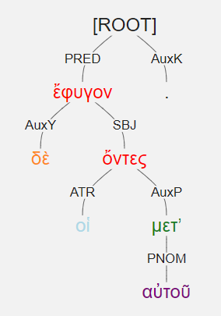
οἱ δὲ μετʼ αὐτοῦ ὄντες ἔφυγον. [1.1.18]
The ones who were with him fled.
Articular participle acting as the SBJ.
It governs the PNOM, μετʼ αὐτοῦ

Slide 25
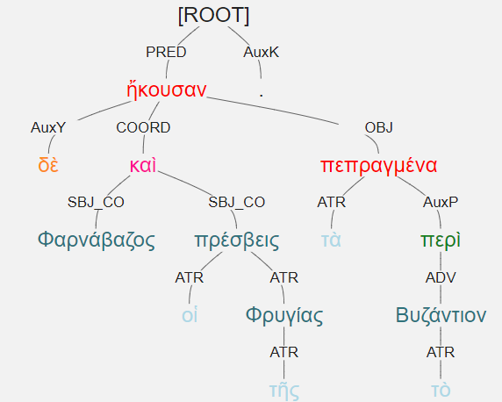
Φαρνάβαζος δὲ καὶ οἱ πρέσβεις τῆς Φρυγίας τὰ περὶ τὸ Βυζάντιον πεπραγμένα ἤκουσαν. [1.4.1]
Pharnabazos and the messengers from Phrygia heard about the deeds around Byzantion.
τὰ πεπραγμένα = the things having been done
περὶ τὸ Βυζάντιον could be labeled as ADV or ATR.
Because it modifies the doing rather than the things, I have opted for ADV

Slide 26
Greek Supplementary Participle
Use the participle to complete the meaning of a verb
Necessary argument with some verbs [often OBJ or PNOM]
Similar to a complementary infinitive
He will prove to be doing nothing wrong. [PNOM]
The participle modifies the SBJ
Requires an OBJ [nothing]
Common verbs taking a supplementary participle
Sensory perception: αἰσθάνομαι, ἀκούω, ὁράω, πυνθάνομαι
Verbs of knowing and showing: οἶδα, οἴομαι, γιγνώσκω, μανθάνω, δηλόω, φαίνω
Verbs of being: τυγχάνω, ἄρχομαι (begin), παύω (stop), ἀνέχομαι (endure), ἔχω (almost “am” or “have been”)
+ nom participle (matching the subject) [PNOM]

Slide 27
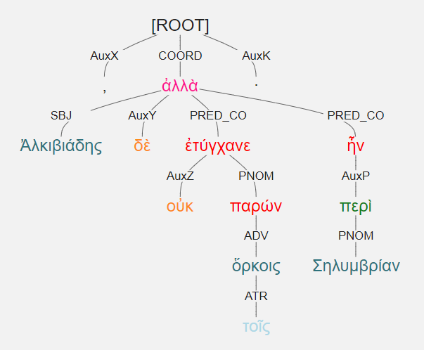
Ἀλκιβιάδης δὲ τοῖς ὅρκοις οὐκ ἐτύγχανε παρών, ἀλλὰ περὶ Σηλυμβρίαν ἦν· [1.3.10]
Alkibiades was not present for the oaths, but [rather] was near Selymbria.
Participle after a verb representing a state of being.
PNOM
Happened to be present
Participle matches the SBJ in gender, number, and case
Nom sg masc

Slide 28
Greek Circumstantial Participle
Optional information
Expresses circumstance, cause, condition, motivation, purpose, etc.
Either modifies an element of the clause or stands absolutely, disconnected from the syntax of the clause.
I drank bottled water. [ATR = condition]
The men, being afraid, fled the battlefield [ADV = cause]
All things being equal, I would prefer to go home now.
Absolute construction = ADV
Requires a SBJ [things] and a PNOM [equal]

Slide 29
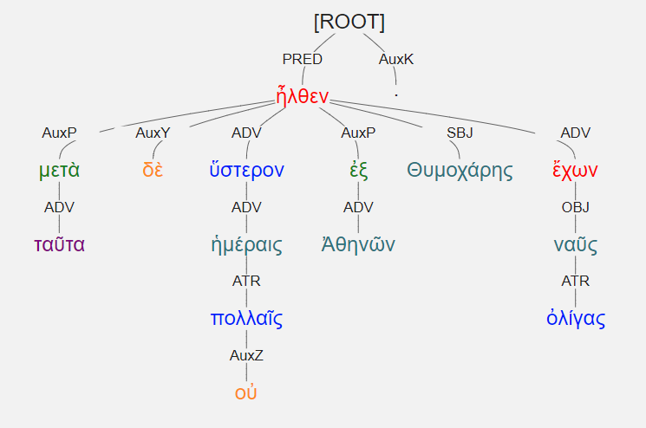
μετὰ δὲ ταῦτα οὐ πολλαῖς ἡμέραις ὕστερον ἦλθεν ἐξ Ἀθηνῶν Θυμοχάρης ἔχων ναῦς ὀλίγας· [1.1.1]
A few days later, after these things, Thymochares came from Athens with a few ships.
Modifies the SBJ, so masc, nom, sg
Has ναῦς as its OBJ.
Literally having a few ships.
Gives additional information
Circumstantial participle = ADV
Translate as seems relevant to the context

Slide 30
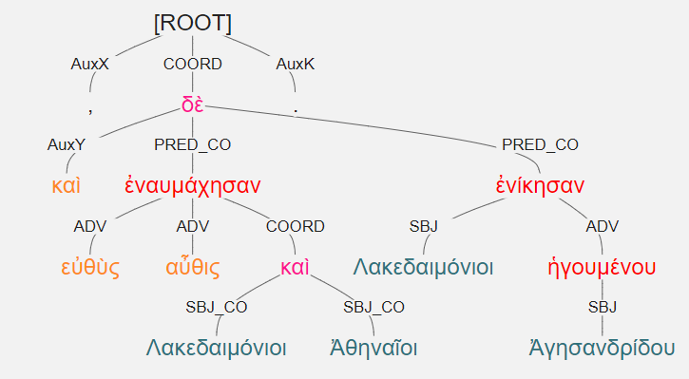
καὶ εὐθὺς ἐναυμάχησαν αὖθις Λακεδαιμόνιοι καὶ Ἀθηναῖοι, ἐνίκησαν δὲ Λακεδαιμόνιοι ἡγουμένου Ἀγησανδρίδου. [1.1.1]
**Genitive absolute**
Can translate when, because, since, after, etc.
And immediately the Lakedaimonians and the Athenians fought another sea battle, and the Lakedaimonians won under the leadership of Agesandridos.

Slide 31
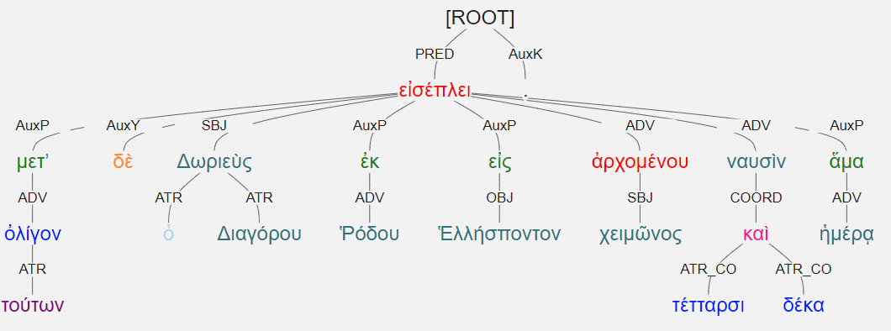
μετʼ ὀλίγον δὲ τούτων Δωριεὺς ὁ Διαγόρου ἐκ Ῥόδου εἰς Ἑλλήσποντον εἰσέπλει ἀρχομένου χειμῶνος τέτταρσι καὶ δέκα ναυσὶν ἅμα ἡμέρᾳ. [1.1.2]
A little after these things, Dorieus, the son of Diagoras, was sailing with fourteen ships from Rhodes into the Hellespont at dawn when winter was beginning.
Genitive absolute = temporal

Slide 32
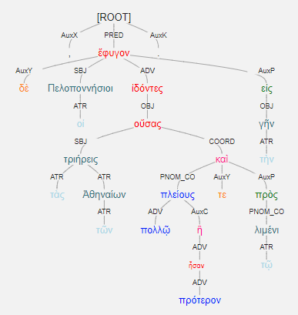
οἱ δὲ Πελοποννήσιοι ἰδόντες τὰς τῶν Ἀθηναίων τριήρεις οὔσας πλείους τε πολλῷ ἢ πρότερον καὶ πρὸς τῷ λιμένι, ἔφυγον εἰς τὴν γῆν. [1.1.17]
Main sentences = The Peloponnesians fled to land.
ἰδόντες = circumstantial participle
From εἶδον, a defective verb [see]
Aor act masc nom pl [seeing]
As a verb of sensory perception, it requires a participle = OBJ
That participle here [οὔσας, being] requires a SBJ and PNOMs

Slide 33
οἱ δὲ Πελοποννήσιοι ἰδόντες τὰς τῶν Ἀθηναίων τριήρεις οὔσας πλείους τε πολλῷ ἢ πρότερον καὶ πρὸς τῷ λιμένι, ἔφυγον εἰς τὴν γῆν. [1.1.17]
When they saw that the Athenian triremes were many more than [they had been] before and they were near the harbor, the Peloponnesians fled to land.

Slide 34
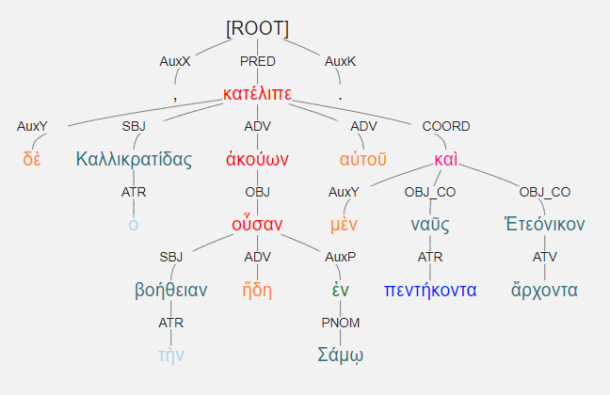
ὁ δὲ Καλλικρατίδας ἀκούων τὴν βοήθειαν ἤδη ἐν Σάμῳ οὖσαν, αὐτοῦ μὲν κατέλιπε πεντήκοντα ναῦς καὶ ἄρχοντα Ἐτεόνικον. [1.6.26]
And when he heard that help was already in Samos, Kallikratides left fifty ships and Eteonikos as the leader.
Note: ἄρχοντα could be participle or noun

Slide 35
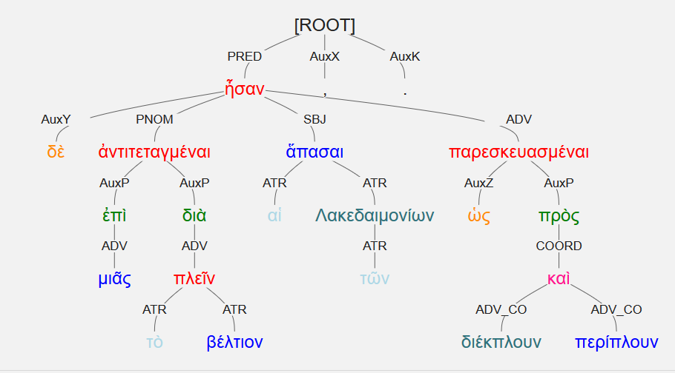
αἱ δὲ τῶν Λακεδαιμονίων ἀντιτεταγμέναι ἦσαν ἅπασαι ἐπὶ μιᾶς ὡς πρὸς διέκπλουν καὶ περίπλουν παρεσκευασμέναι , διὰ τὸ βέλτιον πλεῖν .
The Lakedaimonian ships were all arrayed in one line as if they were preparing to break out and sail around them, because they were better sailors.
ὡς [AuxZ] + participle = intending or on the pretense that

